Slide 1

Introduction to Hyperledger Fabric

Slide 2
Hyperledger Fabric Architecture Overview
Modular Design
Pluggable Consensus
Scalability and Performance
Hyperledger Fabric is built on a modular architecture, allowing for the customization and integration of various components to suit the specific needs of an enterprise.
Fabric offers a choice of consensus protocols, enabling organizations to select the mechanism that best aligns with their requirements and regulatory environment.
The modular design and pluggable consensus mechanisms contribute to Fabric's ability to handle high transaction volumes and provide low latency, critical for enterprise-grade applications.

Slide 3
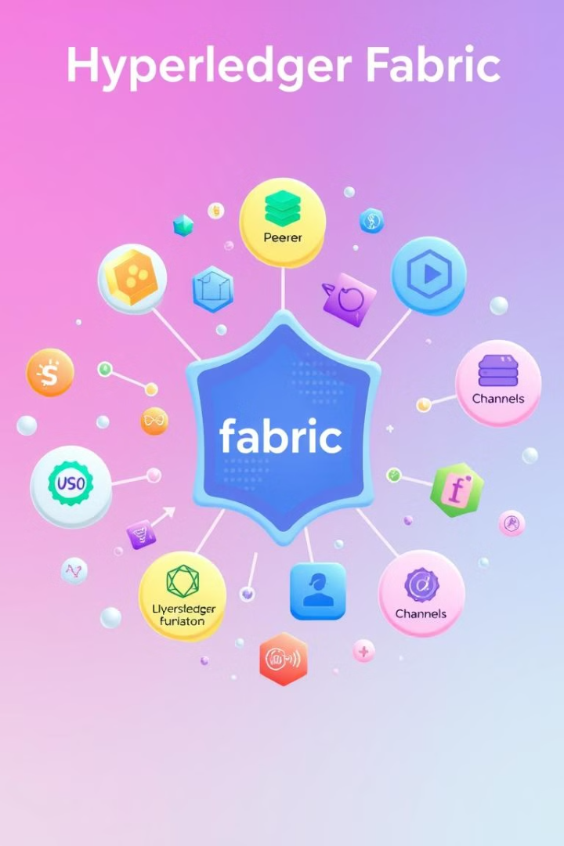
Key Components of Hyperledger Fabric
1
Peers
2
Orderers
The basic building blocks of the Hyperledger Fabric network, responsible for hosting chaincode and maintaining the ledger.
Responsible for collecting endorsed transactions, ordering them into blocks, and distributing the blocks to peers.
3
Channels
4
Chaincode
Provide a private communication mechanism for a subset of network members, enabling confidential transactions and data sharing.
The smart contracts that define the business logic and data model, deployed and executed on the Fabric network.

Slide 4

Transaction Flow in Hyperledger Fabric
1
Proposal
The client application sends a transaction proposal to the relevant peer nodes for endorsement.
2
Endorsement
Peer nodes simulate the transaction and provide their endorsement, verifying the validity of the proposal.
3
Ordering
The endorsed proposal is sent to the ordering service, which gathers and sequences the transactions into blocks.
4
Validation and Commitment
The blocks are then distributed to the peers, who validate the transactions and commit the changes to the ledger.

Slide 5

Consensus Mechanisms in Hyperledger Fabric
Raft
Kafka
A crash fault-tolerant consensus protocol that achieves consensus through an elected leader, providing deterministic and fast transaction finality.
A distributed streaming platform used as the ordering service in Hyperledger Fabric, offering high throughput and scalability.
SOLO
Pluggable Consensus
A simple, single-node ordering service suitable for development and testing environments, not recommended for production use.
Hyperledger Fabric allows organizations to choose the consensus mechanism that best fits their requirements, enabling flexibility and customization.

Slide 6
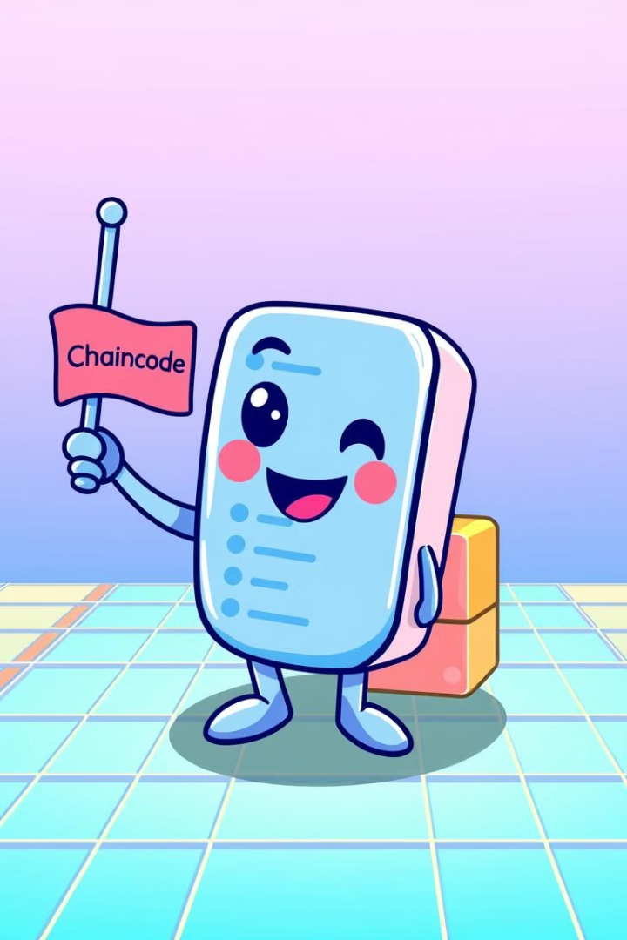




Chaincode (Smart Contracts) in Hyperledger Fabric
Customizable
Secure Execution
Chaincode can be written in various programming languages, allowing developers to leverage their existing skills and tools.
Chaincode runs in a secure and isolated environment, ensuring the integrity and confidentiality of transactions.
Access Control
Versioning
Chaincode can implement fine-grained access controls, restricting who can read, write, or update the ledger.
Chaincode can be upgraded and versioned, allowing organizations to evolve their business logic over time.

Slide 7




Channels and Private Data in Hyperledger Fabric
Channel Creation
Channels provide a private and secure communication mechanism for a subset of network members.
Private Data Collections
Confidential data can be stored in private data collections, accessible only to authorized members of the channel.
Selective Visibility
Channels and private data enable organizations to control the visibility and accessibility of sensitive information, ensuring privacy and compliance.

Slide 8
Enterprise Blockchain Use Cases with Hyperledger Fabric
Supply Chain Traceability
Trade Finance
Healthcare Data Management
Hyperledger Fabric can provide end-to-end visibility and transparency in complex supply chain networks, enabling improved tracking and monitoring of goods.
The platform can streamline trade finance processes, such as letters of credit and trade settlements, by automating transactions and reducing paperwork.
Fabric's privacy and security features can be leveraged to securely store and share sensitive patient data, improving data management and interoperability in the healthcare industry.

Slide 9

Conclusion
Hyperledger Fabric, as a leading enterprise blockchain framework, offers a modular, customizable, and scalable solution for organizations seeking to harness the power of blockchain technology. Its versatile architecture, consensus mechanisms, and privacy-preserving features make it well-suited for a wide range of enterprise-grade applications across various industries.

Slide 10

Thank you

